Slide 1
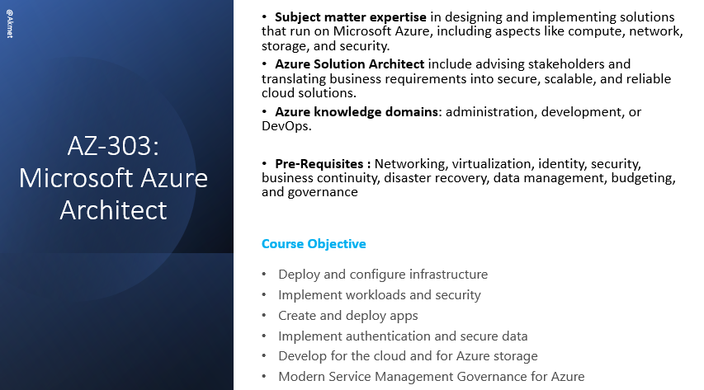

Slide 2
Module 1.1 : Implement and Monitor an Azure Infrastructure
Implement storage accounts
Implement VMs for Windows and Linux
Implement cloud infrastructure monitoring
Implement Azure Active Directory
Automate deployment and configuration of resources
Implement virtual networking
Implement and manage hybrid identities

Slide 3
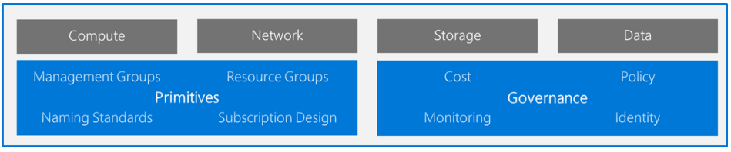
Understanding Landing Zones
A landing zone is the basic building block of any cloud adoption environment. The term landing zone refers to an environment that's been provisioned and prepared to host workloads in a cloud environment like Azure. A fully functioning landing zone is the final deliverable of any iteration of the Cloud Adoption.

Slide 4
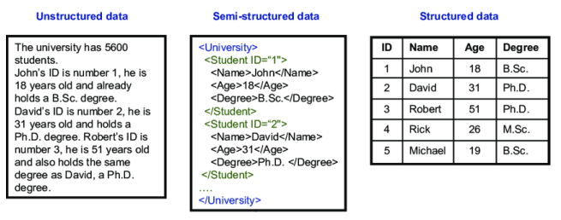
Azure Storage categories
Structured Data
Structured data, sometimes referred to as relational data, is data that adheres to a strict schema, so all of the data has the same fields or properties. Structured data is often stored in database tables with rows and columns with key columns to indicate how one row in a table relates to data in another row of another table.
Semi-Structured
Semi-structured data is less organized than structured data, and is not stored in a relational format, as the fields do not neatly fit into tables, rows, and columns. Semi-structured data contains tags that make the organization and hierarchy of the data apparent - for example, key/value pairs. Semi-structured data is also referred to as non-relational or NoSQL data. For example JSON is an type of semi-structured data
Unstructured Data
The organization of unstructured data is ambiguous. Unstructured data is often delivered in files, such as photos or videos. Therefore, photos, videos, and other similar files are classified as unstructured data. Examples of unstructured data include: • Media files, such as photos, videos, and audio files • Office files, such as Word documents • Text files • Log files

Slide 5
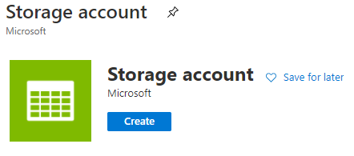
Storage accounts
Azure Storage service , storage solution for modern data storage scenarios , unique namespace for your Azure Storage data , features
Durable and highly available
Secure, Scalable and Managed -
Accessible - HTTP or HTTPS and supports client libraries (.NET, Java, Node.js, Python and REST API)
Encrypted by Storage Service Encryption (SSE) , is encrypted on the service side (256-bit AES encryption)
Data services
Azure blob - text and binary data , big data analytics through Data Lake Storage Gen2 ; for ex : Blob storage: https://*mystorageaccount*.blob.core.windows.net
Azure Files - Managed file shares
Azure Queues - messaging store
Azure Tables - NoSQL store for schemaless storage of structured data
Azure Disks -storage volumes for Azure VMs
Durable and highly available
Type, Performance tier and Access Tier
General-purpose v2 ,v1 accounts – Standard, Premium ; supports Access tiers ; https://*mystorageaccount*.dfs.core.windows.net
BlockBlobStorage accounts - with high transactions rates
FileStorage and BlobStorage accounts
Tips
3 and 24 characters in length and may contain numbers and lowercase letters and must be unique within Azure
BlockBlobStorage accounts - with high transactions rates
FileStorage and BlobStorage accounts

Slide 6
Storage accounts - Access Tires
Storage Access Tier usage pattern of your data , access tier can be changed
Hot access tier - optimized for frequent access, costs are higher , default tier
Cool access tier -optimized for storing large amounts of data that is infrequently accessed and stored for at least 30 days.
Archive tier – offline data tier limitation is remains in the archive tier for at least 180 days , rehydrate process.
Data Redundancy – Available , duplicate
Locally redundant storage (LRS) – replication factor is 3, primary region
Zone-redundant storage (ZRS) - requiring high availability
Geo-redundant storage (GRS) - to protect against regional outages
Control Access to Storage Account, Security
Azure Active Directory - credentials to authenticate, single sign on , MFA
Shared access signature – Token generated by any one of access key to connect storage container , to upload or download files
Disk Encryptions
Ingest data into a storage account – Tools
AzCopy
ADF
Storage Explorer
Limitations
Number of storage accounts per region per subscription, including standard, and premium storage accounts – 250
Maximum storage account capacity – 5 PiB
Maximum number of blob containers – No
Maximum ingress1 per storage account – 10 GBPs

Slide 7
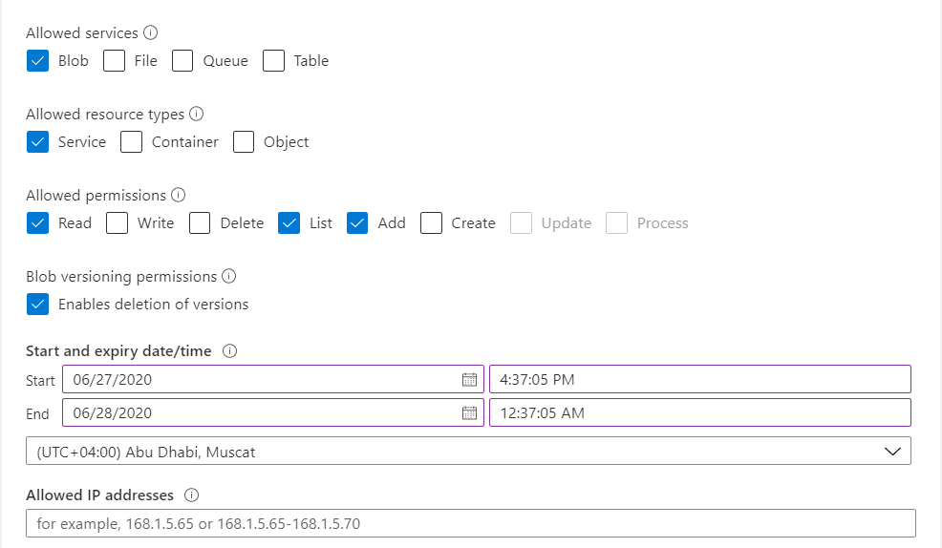
Check-out
Question 1:
You have an Azure storage account named "StorageAccount1". You have gone ahead and created the following Shared Access Signature:
With the Shared Access Signature, could you access all the containers in the storage account on the 27th of June 2020 at 5:00:00 PM?

Slide 8
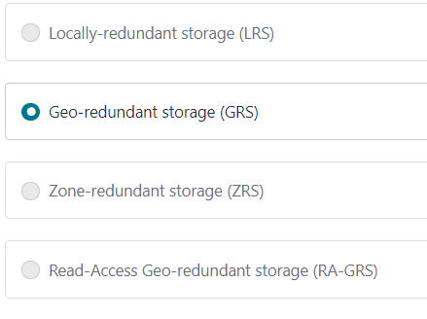
Question 2:
You have several storage accounts defined as part of your subscription. What replication kind provides 6 copies of data?

Slide 9
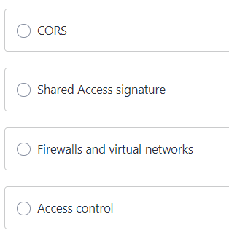
Question 3:
A company has set up a storage account in Azure. They need to ensure that only devices within the IP address range of 141.100.1.0 to 141.100.1.254 has access to the storage account. Which of the following area of the storage account must you configure this setting?

Slide 10
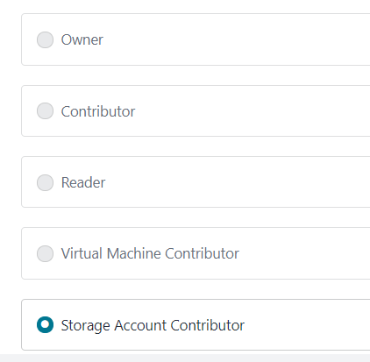
Question 4:
Your company has resources deployed to Azure as part of their subscription. As part of the alignment of permissions with Security, the following permissions need to be assigned to various groups of members:
- GroupA - The users of this group must be able to manage all resources. But they should not have the ability to manage access and authentication for users.
- GroupB - The users of this group must be able to manage Virtual Machines but not the virtual networks or storage accounts associated with Virtual Machines.
- GroupC - The users of this group must be able to manage storage accounts.
You need to assign the appropriate roles for the different groups.
Which of the following role would you assign to the GroupC group of users?

Slide 11
NO
Explanation : You will get an authorization error because the permissions of the Allowed resource types for “Container” is not given.
2. GRS
Explanation : With Geo-redundant storage, you would have three copies in the primary region and three copies of data in the secondary region.
3. Firewalls and virtual Network
4. The Storage Account Contributor role is specifically meant for this type of access.

Slide 12
Module 1.2 : Implement and Monitor an Azure Infrastructure
Implement storage accounts
Implement VMs for Windows and Linux
Implement cloud infrastructure monitoring
Implement Azure Active Directory
Automate deployment and configuration of resources
Implement virtual networking
Implement and manage hybrid identities

Slide 13
Planning Azure Virtual Machine
Virtual Machine design Considerations
Decide the Location for the VM - Datacenters are grouped into. geographic regions (‘West US’, 'North Europe', ‘Southeast Asia’, etc.) to provide redundancy and availability ; there are price differences between locations
Determine the size of the VM - appropriate mix of compute, memory, and storage for what you want to deploy as per business needs. VM size is to consider the type of workload. What if my size needs change?
Understanding the pricing model - Compute costs, Storage costs , Pay as you go ; Reserved Virtual Machine Instances 72% price savings compared to pay-as-you-go pricing
Select an operating system
Fault Domain and Update Domains - share a common power source and network switch ; share a common power source and network switch
Scale Sets - Create and manage a group of load balanced VMs. The number of VM instances can automatically increase or decrease in response to demand or a defined schedule., No cost
Availability Set - logical grouping of VMs within a datacenter that allows Azure to understand how your application is built to provide for redundancy and availability. No cost
Tips
Specify a name of up to 15 characters
Not to be unique name

Slide 14
Azure Virtual Machine
Azure Virtual Machine , on-demand, scalable computing resources, without having to buy and maintain the physical hardware. Purpose
Development and test -specific configurations required to code and test an application
Applications in the cloud - application can fluctuate, and shut them down when you don’t
Extended datacenter - Azure virtual network can easily be connected to private network VPN.
Business Need - can scale up and out to whatever is required to meet your needs
High Availability unique physical locations within an Azure region, Synchronous replication of applications and Data. single point of failure.
VM Affected - Planned maintenance , Unplanned hardware maintenance ; Unexpected downtime
Availability sets – a separated from others. Updated domain (rebooted or undergo maintenance at the same time, patches ) Azure release platform domains, Fault Domain (own network, power, and cooling infrastructure) – Physical failure points – SLA - https://azure.microsoft.com/en-us/support/legal/sla/virtual-machines/v1_9/
Availability Zone
Configure storage and VM Size -
General-purpose – A, B ,D – development and testing
Compute Optimized – F; CPU to memory is high , App server
Memory optimized – E; Database Servers.
Storage Optimized – Ls ; Big Data, SQL, NoSQL databases, data warehousing and large transactional databases.
GPU – NC ; Heavy graphic rendering and video editing, as well as model training and inferencing (ND) with deep learning.
Virtual Machine Scale set and Disk Encryption
is a framework or an abstraction of VM; group of VMs Deploy a set of load-balanced and identical VMs ; scaled vertically or horizontally to meet demand of business; No cost , pay only for VMs

Slide 15
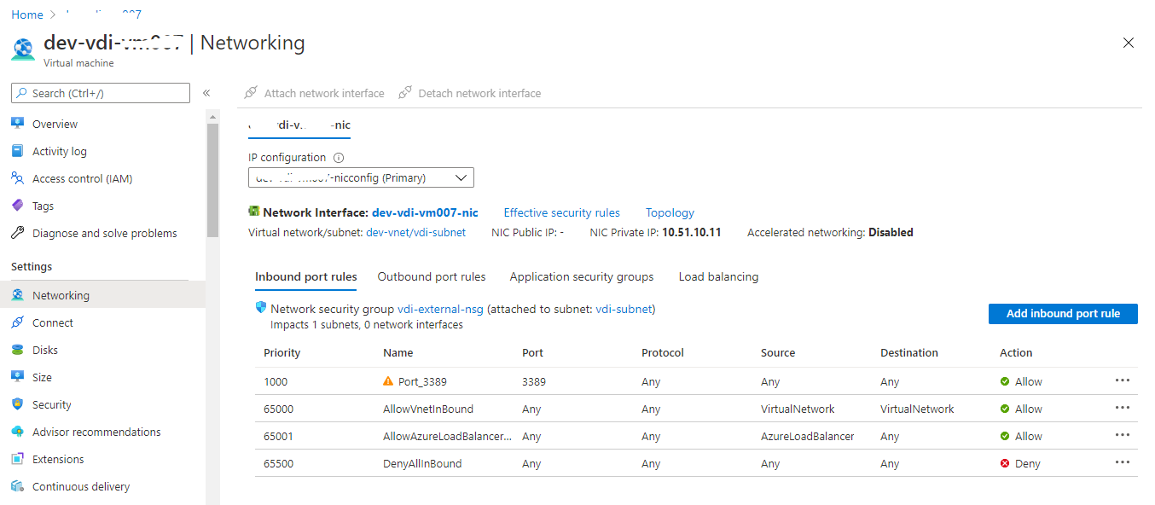
Azure Virtual Machine NSG
Azure Virtual Machine NSG, Network security Group is setting , inbound , outbound port Rules and actions Allow / Deny
Development and test -specific configurations required to code and test an application
Applications in the cloud - application can fluctuate, and shut them down when you don’t
Extended datacenter - Azure virtual network can easily be connected to private network VPN.
Business Need - can scale up and out to whatever is required to meet your needs
High Availability unique physical locations within an Azure region, Synchronous replication of applications and Data. single point of failure.
VM Affected - Planned maintenance , Unplanned hardware maintenance ; Unexpected downtime
Availability sets – a separated from others. Updated domain (rebooted or undergo maintenance at the same time, patches ), Fault Domain (own network, power, and cooling infrastructure)

Slide 16
Azure Virtual Machine –Vnet
Azure Virtual Machine V net , Azure VM uses Vnet to communicate with VMs, Azure SQL database and other Azure Services.
Network Interfaces – Each VM Must have at least a one NIC , can have multiple
Subnet – Network Boundary , Control traffic flow to and from the resources in the subnet
IP Address- Public – Communicate to and from the internet ; Privat – Communicate with virtual machines in the same network(Virtual or on-premise) –
IP address – Dynamic – IP Address assigned after the virtual machine is started and released when the VM is Stopped, IP Address can Change ; Static – IP Address assigned immediately and can not change.
Network Security Group – Provides Network Isolation , Rules that can deny or allow traffic , Rule Contains – Source IP , Source Port ; Destination IP and Destination Port
Network Load Balancer- Internal – balances traffic between VM in a Vnet ; External – Balances traffic between Internet to VM

Slide 17
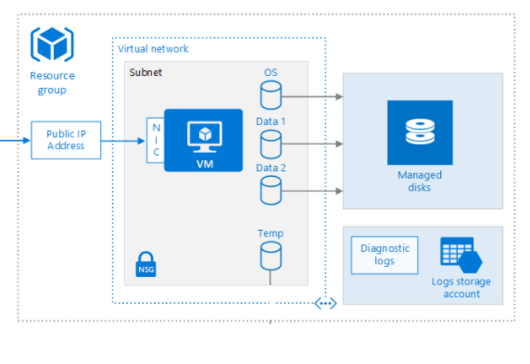
Azure Virtual Machine
Virtual Network
NIC - interconnection between a VM and a virtual network (VNet), at least one NIC and is automatically created
IP addresses - Public & Private IP addresses. - public IP addresses to VMs or internet-facing load balancers. You can assign private IP addresses to VMs and internal load balancers.
Network security groups - rules that allow or deny network traffic to subnets, NICs, or both (inbound and outbound)
Access and Security
RDP – port 3389 ; Remote d
Baston - Azure service that allows fast, secure connections to any VM within a VNet
Azure Queues - messaging store
Azure Tables - NoSQL store for schemaless storage of structured data
Azure Disks -storage volumes for Azure VMs
Durable and highly available
Operations
Diagnostics – Basic health metrics, diagnostics infrastructure logs
Availability– planned maintenance or unplanned downtime
Stopping and Deleting a VM – E; Database Servers.

Slide 18
Azure Virtual Machine Disk
Azure Virtual Machine Disk, has two disk by default
Operating system Disk (C) – SATA drive; Max Capacity of 2048 GB
Temporary Disk (D) – Page or swap files; Data may be lost ; Do not store data on this disk
Data Disk – Store App Data , SCSI Drive, Max Capacity of 4095 GB

Slide 19
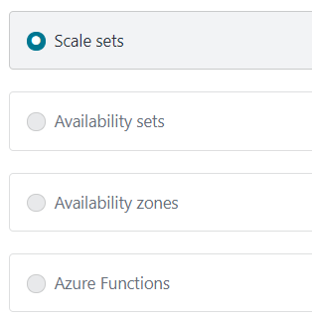
Check Out
Question 1:
You have a set of virtual machines that are hosting mission-critical applications. You have to ensure the experience of virtual machines experiences as little downtime as possible. Which of the following can you use to maintain application performance across an identical set of Virtual Machines?

Slide 20
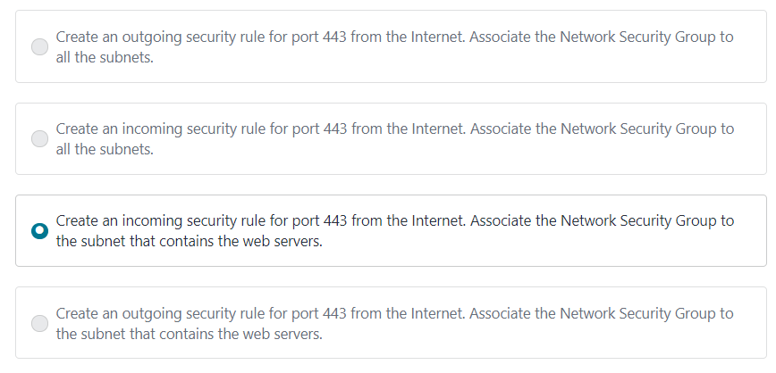
Question 2:
You are planning the move of some app to Azure. You create a network security group (NSG). You need to recommend a solution to provide users with access to the app. What should you recommend?

Slide 21
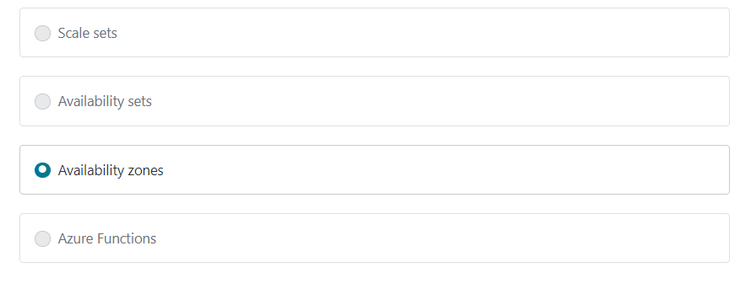
Question 3:
You have a set of virtual machines that are hosting mission-critical applications. You have to ensure the experience of virtual machines as little downtime as possible.
Which of the following can you use to maintain application availability when an Azure datacenter fails?

Slide 22
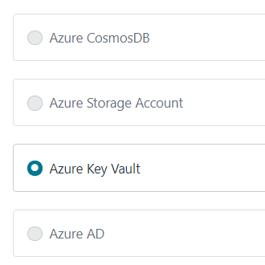
Question 4:The following requirements need to be met for the Virtual Machine.
The underlying data disks for the Virtual Machine need to be encrypted.
The company does not want to store the encryption keys locally.
Which of the following would be used for the management of the encryption keys?

Slide 23
If you have an identical set of virtual machines, you can use Virtual Machine scale sets and scaling conditions to maintain application performance.
If you have a Network Security group, change the Incoming rules to allow port 443. This is so that users from the Internet can access the web server on the secure port 443.
You can use Availability zones to help protect against datacenter level failures.
You should use the Azure key vault service for managing the encryption keys.

Slide 24
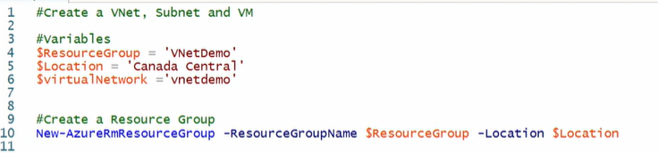
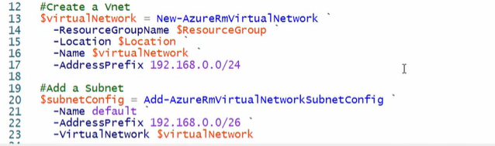

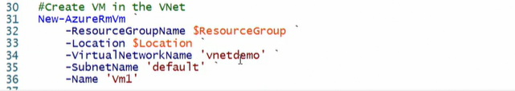
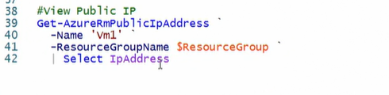
Hands-On Azure VM and Network

Slide 25
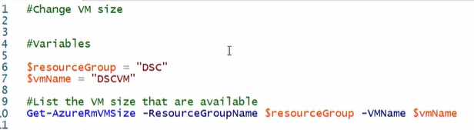

Hands-On Azure VM and Resize

Slide 26
Module 1.3 : Implement and Monitor an Azure Infrastructure
Implement storage accounts
Implement VMs for Windows and Linux
Implement cloud infrastructure monitoring
Implement Azure Active Directory
Automate deployment and configuration of resources
Implement virtual networking
Implement and manage hybrid identities

Slide 27
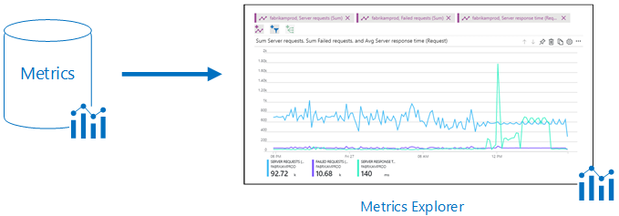
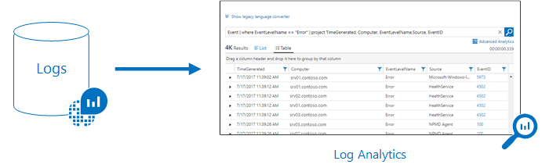
Azure monitoring
Azure Monitor
Azure service which collect, analyze and act on telemetry data from your Azure and on-premises environments of two types Metrics and Logs . Used to monitor apps and infra structure
The goal of Azure monitoring solution used collects the metrics and operational logs generated by azure resources, application build using control tower solution architecture and will be analyzed using Log Analytics. Alerts can be configured to identify occurrence of the performance and operation issues on application and azure resource and action can be automated with diagnostic setting in both application and azure resources
The services created and used like ADF, ADLS, Azure databricks and cosmos db and we have to configure diagnostic setting to collect more details logs
Open configured resource : Storage

Slide 28
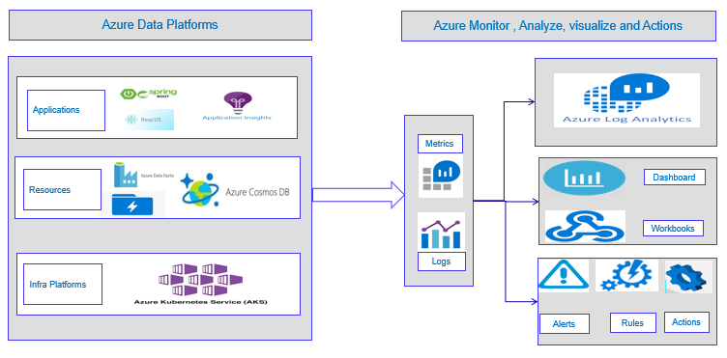
Azure monitoring Apps and resources
Log Analytics workspace
This service needs be created and prompted when do diagnostics setting

Slide 29
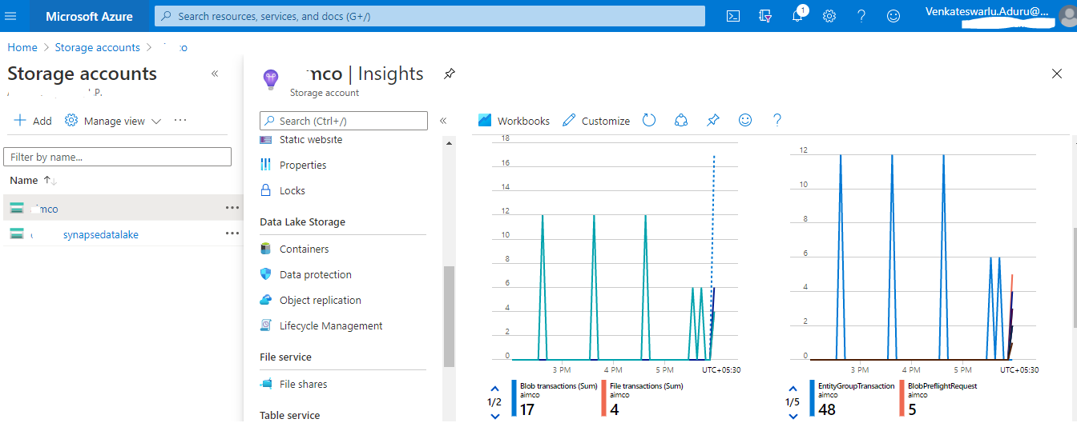
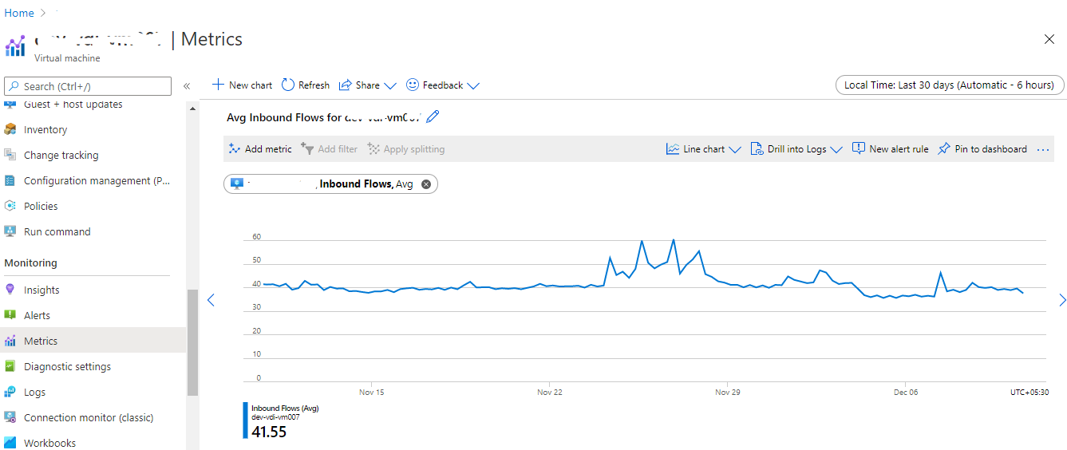
Azure monitoring Storage account

Slide 30
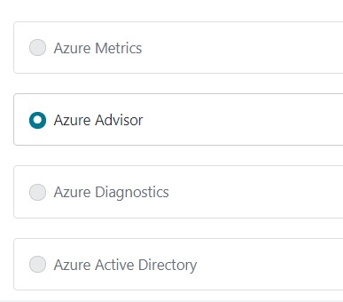
Check Out
Question 1:
A company is currently hosting 50 Virtual Machines as part of their subscription.
The senior management has given instructions to conduct a review and identify any underutilized virtual machines. This is to ensure that cost is managed effectively for the Azure Virtual Machines. Which of the following could you use for this purpose?

Slide 31
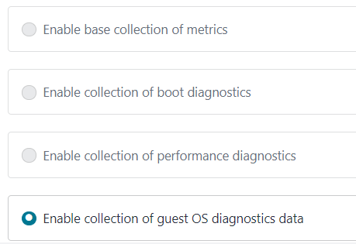
Question 2:A company has the following windows virtual machines deployed to their subscription in Azure:
VM1
VM2
The Monitoring department needs to collect certain performance-based counters from the virtual machines. Which of the following could help accomplish this?
If you enable collection of guest OS diagnostics data, you will have the ability to collect data on the performance counters on Windows based virtual machines.

Slide 32
Module 1.4 : Implement and Monitor an Azure Infrastructure
Implement storage accounts
Implement VMs for Windows and Linux
Implement cloud infrastructure monitoring
Implement Azure Active Directory
Automate deployment and configuration of resources
Implement virtual networking
Implement and manage hybrid identities

Slide 33
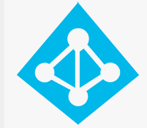
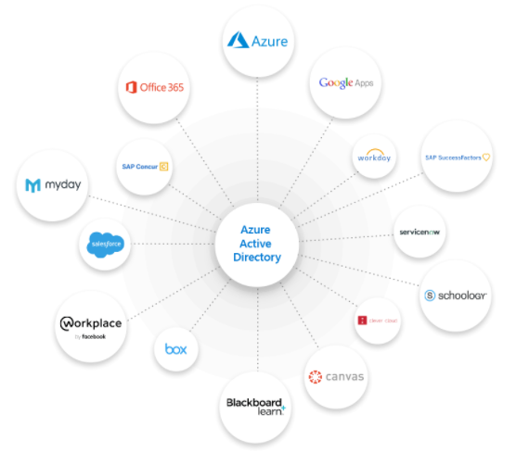
Azure Active Directory
Azure Active Directory, cloud-based identity and access management as a service ( domain services), which helps your employees sign in and access resources ; universal identity platform to manage and secure identities to protect business ; enterprise identity service provides single sign-on and multi-factor authentication to help protect your users from 99.9 percent of cybersecurity attacks; Internal and external users more securely ; Connect your workforce . Purpose - right people have the right access to the right resources. Includes the tenant's users, groups, and apps and is used to perform identity and access management functions for tenant resources
Single sign-on - access to your apps from anywhere
Multi-factor authentication - protect and govern access
Common identity and access capabilities to all web services;
AKA, Build directly on the cloud, same as O365 directory service and sync with On-Premises directory services
Pre-Integration Supports more than2,800 pre-integrated software as a service (SaaS) applications.
Active Directory ~ Azure Active Directory
Next evolution of identity and access management solutions for the cloud.
Manually (Microsoft Identity Manager) ; automatically (Sync)
domains, organizational units, and groups in AD to delegate administrative rights; built in roles – RBAC - role-based access control
Credentials Management - based on passwords, certificate authentication, and smartcard authentication; MFA , Self service password reset
LDAP, Kerberos ; Internet Protocol
Identity
In Computing identity is a representation of a person, application or device. Mail ID, SSN , PAN etc , what is required ? Password or key or certificate etc
Tip Azure AD directory comes with an initial domain name, domainname.onmicrosoft.com.
Notes:
Why AAD ? To create and manage users and groups, and enable permissions to allow and deny access to enterprise resources.

Slide 34
Client –Server Model
Client App
Web Browser
Mobile App
Server Web Site
User Id , Password
Traditionally hacks are more because of the
Stored in database
Password – Plain text
Hash or MD5 Algorithm
Not enforcing change policies
Complexities
Database Server

Slide 35
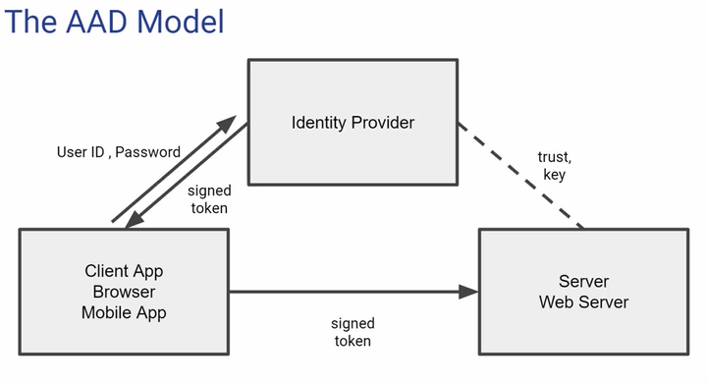
Azure Active Directory
Why AAD
Enterprise Identity Solution, Simple Connect and Single Sign-On, MFA and Self Service
Easy to maintain – no need to manage it manually
Centralized Administration -SSO , MFA
Integrated with other Azure services

Slide 36
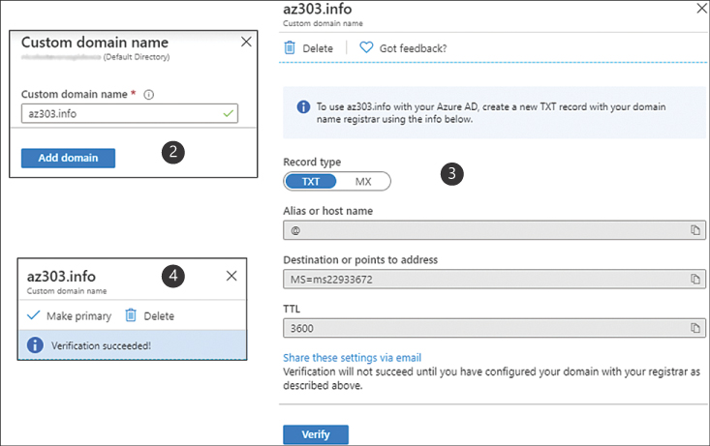
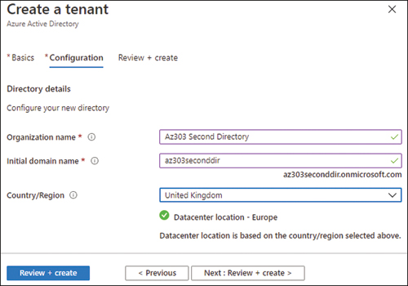
Azure Active Directory – Custom domain , Tenant

Slide 37
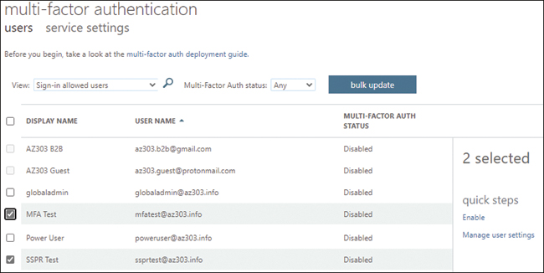
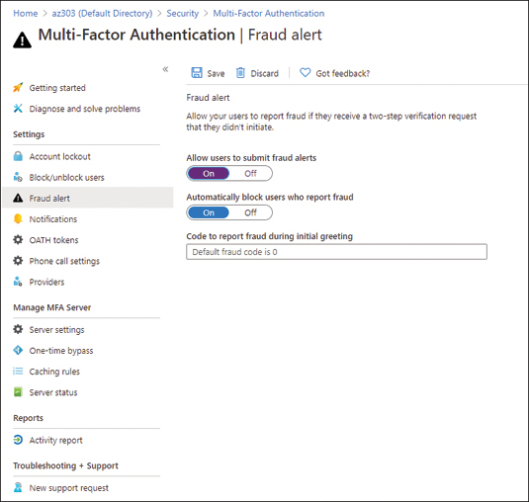
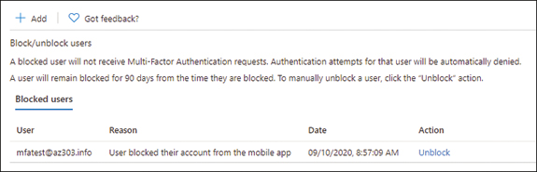
Azure Active Directory – Multi Factor Authentication

Slide 38
Azure Active Directory Terminology
Identity - A thing that can get authenticated ; Credentials ;
Account - An identity that has data associated with it
Azure AD account - An identity created through Azure AD or another Microsoft cloud service, such as Microsoft 365.
Account Administrator - Subscription administrator role is conceptually the billing owner of a subscription.
Service Administrator - administrator role enables you to manage all Azure resources, including access.
Owner -role helps you manage all Azure resources, including access
Azure subscription - Used to pay for Azure cloud services.
Azure tenant - A dedicated and trusted instance of Azure AD that's automatically created when your organization signs up for a Microsoft cloud service subscription; represents a single organization , Single (dedicated environment) , Multi (shared environment) tenant ;
Azure AD directory - Each Azure tenant has a dedicated and trusted Azure AD directory;
Microsoft account (also called, MSA)

Slide 39
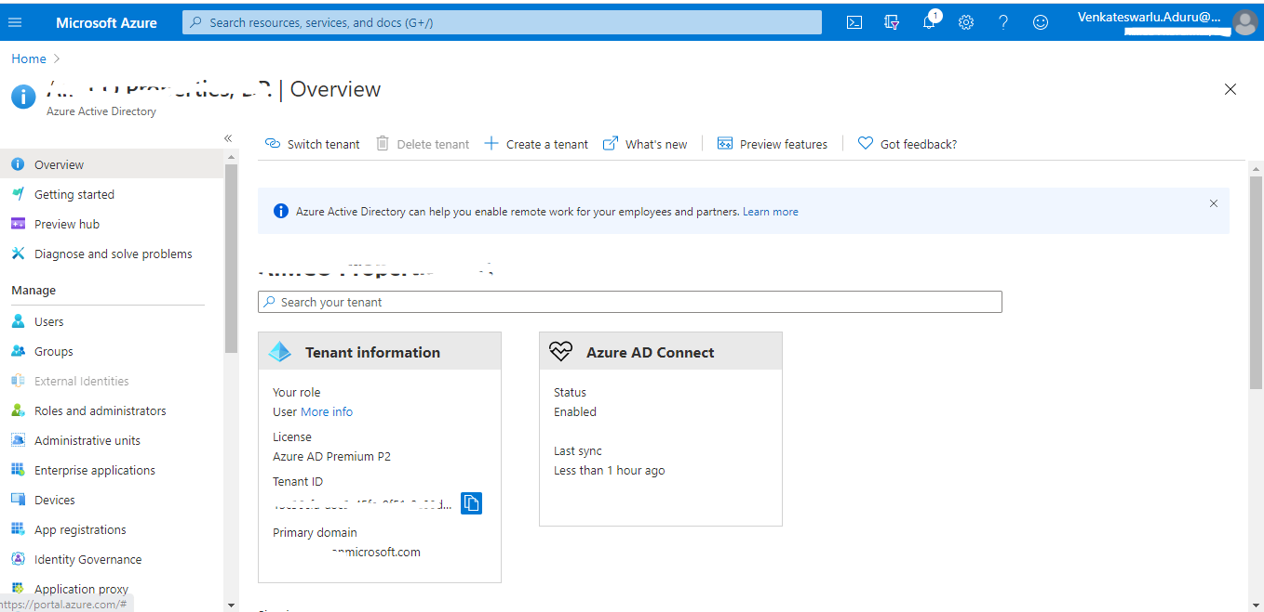

Slide 40
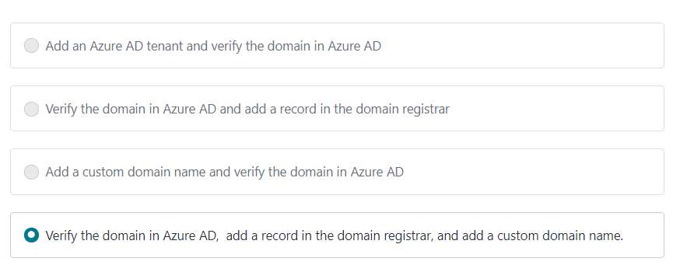
Check Out
Question 1:
Your company has set up an Azure AD tenant with the domain name of softwarearchitect.onmicrosoft.com. The company has purchased the domain softwarearchitect.com from a domain registrar. They want to ensure now that they can define users in Azure AD with the suffix of @softwarearchitect.com.
Which of the following steps would you need to implement for this? Choose three answers from the options given below.

Slide 41
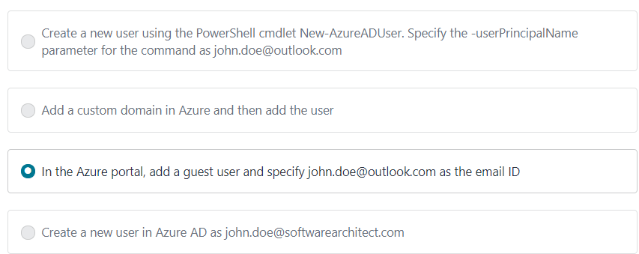
Question 2:
A company has an Azure AD tenant named whizlabs.com. The company hires a consultant to perform some work. The consultant needs to authenticate to the tenant using a Microsoft account names john.doe@outlook.com Which of the following would you do to fulfill this requirement?

Slide 42
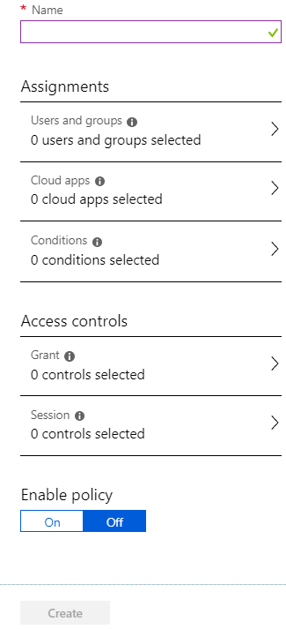
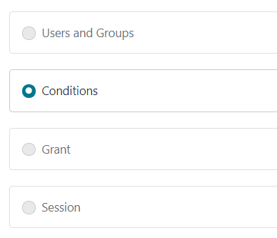
Larger image
Question 3:
A company has an Azure account and currently has an Azure premium P2 based subscription. As an IT administrator, you have to configure a conditional access policy as shown below
You have to ensure the following key requirement:
Users from select locations would need to authenticate using MFA.
In which of the following sections would you configure the locations for the policy?

Slide 43
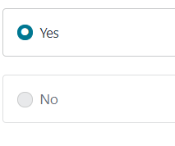
Question 4:
A group has been created and all users have been added as part of the group. You create a conditional access policy that enforces the use of multi-factor authentication for the group for all cloud-based applications.
Would User1 with a Multi-factor authentication status of "Enforced" be required to use multi-factor authentication when signing into Azure via the web browser?

Slide 44
2 . If you have an external user who is not part of your domain, you can create a new guest user in Azure AD
4. If the user state is in the Enforced state, then the user will need to use MFA for the login process

Slide 45
Module 1.4 : Azure Active Directory
Implement storage accounts
Implement VMs for Windows and Linux
Implement cloud infrastructure monitoring
Implement Azure Active Directory
Automate deployment and configuration of resources
Implement virtual networking
Implement and manage hybrid identities

Slide 46
Hands-on 1 : Azure Portal
Azure portal : https://portal.azure.com/
Azure services (Storage, Virtual Machine)
Dashboard
Settings, notifications
Azure Market Place
How to create a service in azure cloud

Slide 47
Hands-on 1 : Azure Storage Account
Azure portal : https://portal.azure.com/
Azure services
Dashboard
Settings, notifications
Azure Market Portal
How to create a service

Slide 48
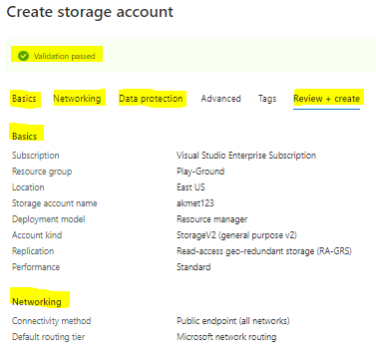
Hands-on 1 : Azure Storage Account
The below are the steps to create Storage using Azure portal
Step1. Log into Azure portal : https://portal.azure.com/
Step2. Click on Create a resource and search for storage account
Step3. Storage blade will open and click on create
Step4 . Provide name , resource group and other required details
Step 5. Fill and Complete all section in the creation
Step 6. validate successfully
Step 7. Click on create , account will be created.
Use case or scenarios :
Azure Blob support streaming and random access scenarios.
Azure Tables Azure Cosmos DB Table API

Slide 49
Hands-on 1 : Azure Virtual Machine
Azure portal : https://azure.portal.com
Create Virtual machine
Network Security Group configuration
Resize VM
Azure Market Portal
How to create a service

Slide 50
Module 1.5 : Virtual Networking
Implement storage accounts
Implement VMs for Windows and Linux
Implement cloud infrastructure monitoring
Implement Azure Active Directory
Implement virtual networking
Automate deployment and configuration of resources
Implement and manage hybrid identities

Slide 51
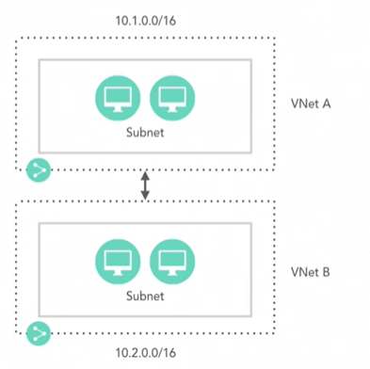
Azure Virtual Networking
Azure Virtual Networking, Fundamental building block for private network in Azure. VNet enables Azure Virtual Machines (VM), to securely communicate with each other ( with service endpoint , Peering , Connect virtual networks within the same Azure region , low-latency, high-bandwidth), the internet, and on-premises networks. Like a traditional network operate in own datacenter but with additional benefits of Azure's infrastructure such as scale, availability, and isolation. And helps filtering network traffic, routing network traffic, and integration with Azure services.
Azure IP Addressing :
Public IP (Basic / Standard SKU) : Like a public IP on-premise. Used to connect internet , other azure public-facing services ( SQL DB , Azure Storage)
Assign to VM Primary NIC , VPN Gateways, Application Gateways , and Internet-facing Load balancers
Public IP – Dynamic – Default , Not assigned when VM created and assigned on VM start up, Released when VM restarted, stopped or deallocated ; Static – Assigned when VM Provisioned, Never Released unless – deleted the resource / Change to Dynamic. – Use cases Linked to SSL certificate or services required a static IP
Vnet Peering – Connect two subnets
Same or different region
Different Subscriptions for seamless communication
Limitations
https://docs.microsoft.com/en-us/azure/azure-resource-manager/management/azure-subscription-service-limits#networking-limits
Best Practices Not Apply Static IP to the OS of VM
Notes:
Why AAD ? To create and manage users and groups, and enable permissions to allow and deny access to enterprise resources.

Slide 52
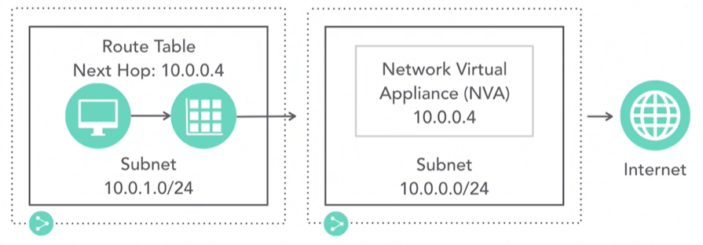
Private IP:
Assign a VM with in the VPN
Connect to an On-Premise environment (VPN Gateway, EpressRoute), Not accessible to internet.
Assigned – Virtual Machine each NIC , Internal Load balancers , Application gateways.
Private IP – Dynamic – Default , Not assigned when VM created and assigned on VM start up, Released when VM stopped, may change from reboot to reboot .
Private IP – Static – Assigned when VM Provisioned, Never Released , don’t private IP within the server. Use cases Domain Controllers , DNS servers, other services required a static IP
NVA – VPN , Virtual Network, Internet
Azure Route table and NSG :
Two separate entities.
Both can be applied to subnet.
NSG – Security rules to allow or deny traffic
Route table – Directs traffic
Virtual Machine each NIC , Internal Load balancers , Application gateways.
Private IP – Dynamic – Default , Not assigned when VM created and assigned on VM start up, Released when VM stopped, may change from reboot to reboot .
Private IP – Static – Assigned when VM Provisioned, Never Released , don’t private IP within the server. Use cases Domain Controllers , DNS servers, other services required a static IP

Slide 53
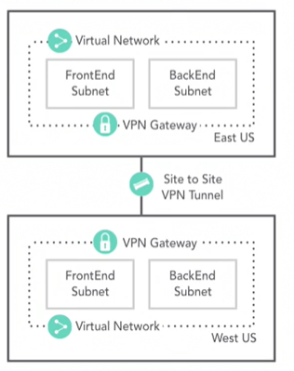
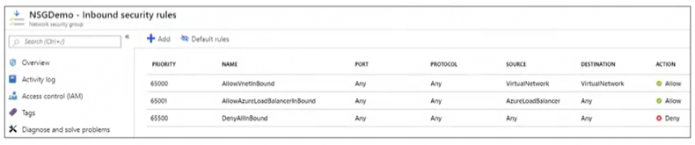
Azure Virtual Network Subnets
Site to Site VPN– Connect Vnets in different region and subscriptions
Require Vnet Gateway
Provide Secure Tunnel
NSG - List of Rules ,Allow or Deny traffic, Applied to Subnet (All VMs in Subnet ) / NIC (affects the VM), Inbound or Outbound
Default inbound security rules – AllowVnetInbound, AllowLoadbalencerInbound, denyAllInbound

Slide 54
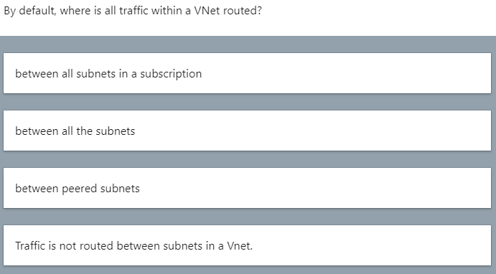
Check On

Slide 55
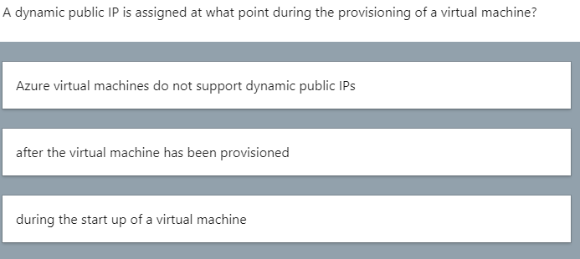

Slide 56
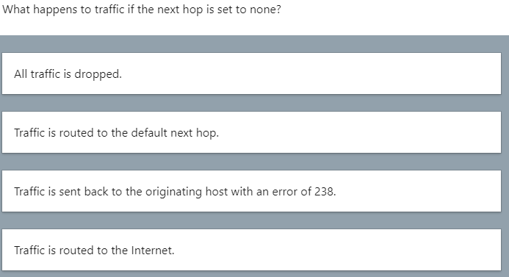

Slide 57
Between the all subnets
During the start up of VM
All traffic is dropped

Slide 58
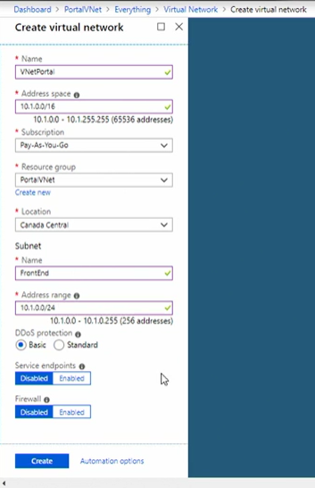
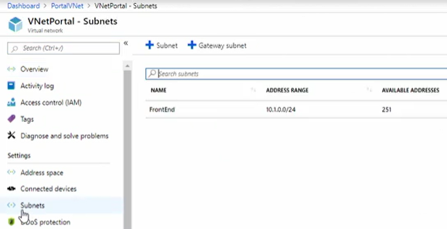
Hands-on 3 : Azure Virtual Network
The below are the steps to create Vnet using Azure portal
Step1. Log into Azure portal : https://portal.azure.com/
Step2. Click on Create a resource and search for Virtual Network
Step3. Vnet blade will open and click on create
Step4 . Provide name : frontEnd , Address Space: 10.1.0.0/16 and other required details
Step 5. Fill address range : 10.1.0.0/24 all section in the creation
Step 6. validate successfully
Step 7. Click on create , Vnet will be created.
For example, refer the below screen-shot

Slide 59

Hands-on 3 : Azure Virtual Network …
The below are the steps to create one more subnet
Step1. Continue from previous step and create a one more subnet
Step2. Add address range : 10.1.1.0/24
Step3. Configure NSG ,Routing Table and service End Point
Step4 . Step 6. validate successfully
Step 7. Click on create , Subnet will be created.

Slide 60

Hands-on 3 : Azure Virtual Network …
The below are the steps to create NIC
Log into Azure portal : https://portal.azure.com/
Step2. Click on Create a resource and search for NIC
Step3. Provide details and validation successful
Step4. Click create button
Step 5. perform a Ip configuration.

Slide 61
Module 1.6 : Automatic deployment
Implement storage accounts
Implement VMs for Windows and Linux
Implement cloud infrastructure monitoring
Implement Azure Active Directory
Implement virtual networking
Automate deployment and configuration of resources
Implement and manage hybrid identities

Slide 62
Automation with Azure PowerShell CLI and ARM Templates
Azure Resource Creation using Azure CLI Open Power ISE
Login to Azure account with Sign in with Azure CLI , visual Sudio code
Create a resource group
Create a Storage account
Create a Virtual machine
Pre-Requisites
1. Install Microsoft Azure CLI
https://docs.microsoft.com/en-us/cli/azure/install-azure-cli-windows?tabs=azure-cli

Slide 63
Azure CLI - Resource group
Step1. Login to Azure account - az login
az account
az group
az group list
az group create
Step 2. Create a resource group powershell script
PS > az group create --location 'centralus' --name myresourcegroup1 --tags env: demo
Step 3. Login to portal and check the details
Step 4. delete resource Group
Step 5 . Logout from Az logout
Step 6. list resource group
az group list --output table

Slide 64
Azure CLI - Storage account
Step1. Login to Azure account
Step 2. Create a Storage Account powershell script
storage account create --name demostorage --resource-group myresourcegroup1 --access-tier Cool --kind StorageV2
storage container-rm create --storage-account demostg223 --name test --resource-group cloud-shell-storage-centralindia
Step 3. Login to portal and check the details
Step 4. delete Storage Account
Step 5 . Logout from Az logout

Slide 65
Azure CLI - Virtual Machine
Step1. Login to Azure account
Step 2. Create a Virtual machine powershell script
vm create --name myvm -g myresourcegroup1 -l centralus --admin-username sadmin --admin-password Venkat1234567 --image Win2012Datacenter
Step 3. Login to portal and check the details
Step 4. delete Virtual Machine
Step 5 . Logout from Az logout
Step 6 Vnet
network vnet create --name ventdemo --resource-group cloud-shell-storage-centralindia

Slide 66
Azure CLI - Interactive
Step1. Login to Azure account
Step 2. Create a Virtual machine powershell script
Step 3. Login to portal and check the details
Step 4. delete Virtual Machine
Step 5 . Logout from Az logout

Slide 67
Automation with ARM Templates
Azure Resource Manager templates are JavaScript Object Notation (JSON) files that define the infrastructure
Azure Resource Creation using Azure CLI Open Power ISE
Login to Azure account with Sign in with Azure CLI , visual Sudio code
Create a resource group
Create a Storage account
Create a Virtual machine
Pre-Requisites
1. Install Microsoft Azure CLI
https://docs.microsoft.com/en-us/cli/azure/install-azure-cli-windows?tabs=azure-cli

Slide 68
Module 1.7 : Manage hybrid identities
Implement storage accounts
Implement VMs for Windows and Linux
Implement cloud infrastructure monitoring
Implement Azure Active Directory
Implement virtual networking
Automate deployment and configuration of resources
Implement and manage hybrid identities

Slide 69
Reference
https://docs.microsoft.com/en-us/azure/storage/blobs/
https://docs.microsoft.com/en-us/azure/virtual-machines/windows/
Use case

